Slide 1
Project HR Analytics: Employee Retention

Slide 2
Group Members:
Aishwarya Singh
Dnyaneshwar Shinde
Rajaram Setty C V
Ritika Singh
Sharad Nathwani
Vaishnavi Dhembare
Venkatesh P Gangji

Slide 3
Objective
To Identify the reason for employee attrition and take necessary steps for Employee Retention.

Slide 4
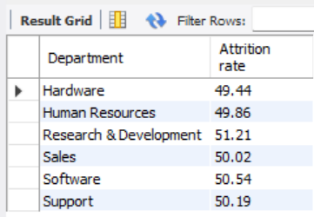
KPI 1 - Average Attrition rate for all Departments
All the departments are having Attrition rate of around 50%.
Hardware(49.44%) and Research and Development(51.21%) having the lowest and highest attrition rate respectively.

Slide 5
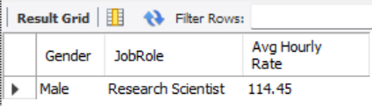
KPI 2 - Average Hourly rate of Male Research Scientist
The Average hourly rate of a male research scientist is 114.45.

Slide 6
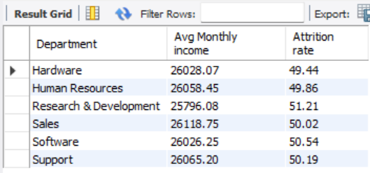
KPI 3 - Attrition rate Vs Monthly income stats
Research and Development is having lowest average monthly salary of 25796.08.
Sales is having highest average monthly salary of 26118.75.
Average salary is in the range of 25700.00 to 26200.00 department wise.

Slide 7
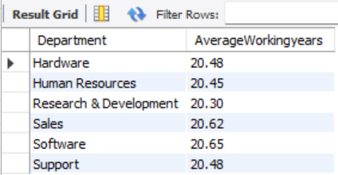
KPI 4 - Average working years for each Department
Employees in all the departments have an average overall working experience of around 20 years.
Research & Development and Software having the lowest(20.30) and highest(20.65) respectively.

Slide 8
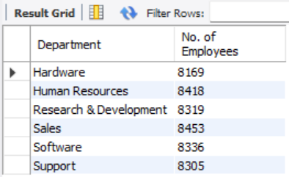
KPI 5 – Department wise No of Employees
Hardware department has the lowest number of employees.
Sales department has the highest number of employees.
The number of employees in each department ranges between 8100 to 8500.

Slide 9
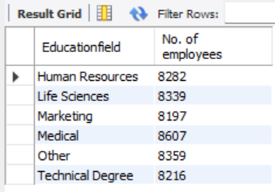
KPI 6 - Count of Employees based on Educational Fields
Lowest number of employees are having marketing education field.
Highest number of employees are having medical education field.
The number of employees in each education field ranges between 8100 to 8700.

Slide 10
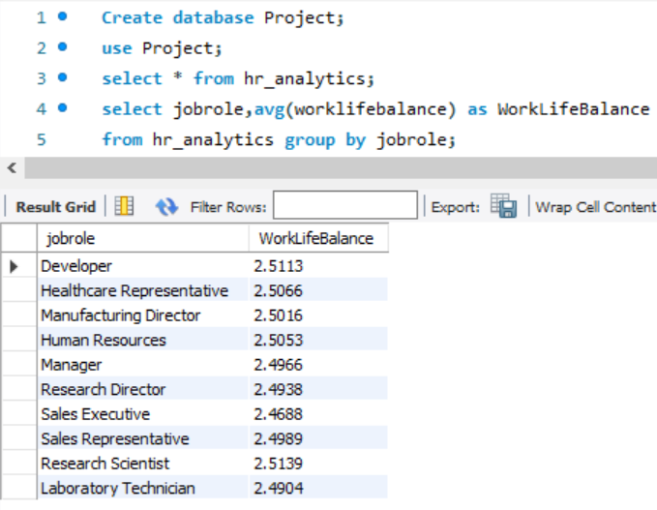
KPI -7 Job Role vs Work Life Balance
As per our observation, the work life balance of all department is approximately same except some departments.
In conclusion, the pursuit of a balanced life is not a compromise but a strategic investment.
It's a recognition that personal growth, relationships, and rejuvenation are foundational to excelling in any job role.

Slide 11
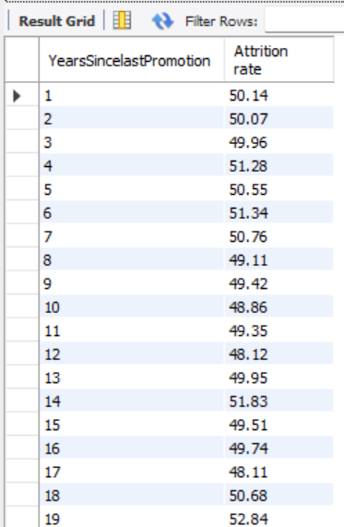
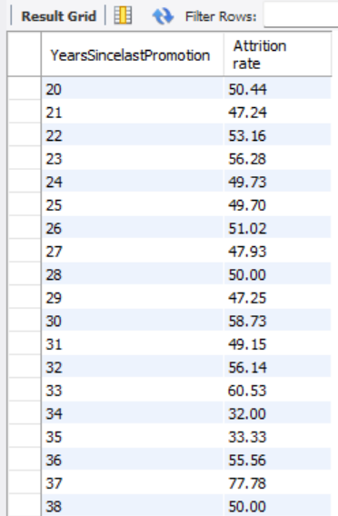

KPI 8 - Attrition rate Vs Year since last promotion relation
34 Years since last promotion is having the lowest attrition rate of 32.00%.
37 Years since last promotion is having the highest attrition rate of 77.78%.

Slide 12
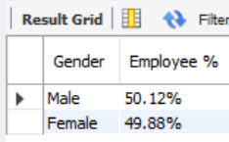
KPI 9 - Gender based Percentage of Employee
The percentage of male employees is 50.12%.
The percentage of female employees is 49.88%.
Approximately equal number of Male and Female employees

Slide 13
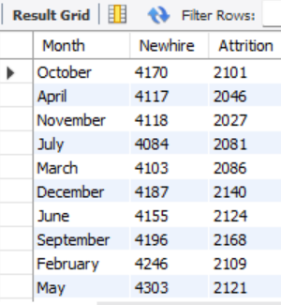
KPI 10 - Monthly New Hire vs Attrition Trendline
From the table we can observe that the New hire count is close to double of the attrition count.
The Month of August and May have the lowest(4060) and highest(4303) number of new hires respectively.
The Month of August(1977) and September(2168) have the lowest and highest number of attrition respectively.
Notes:
\]

Slide 14
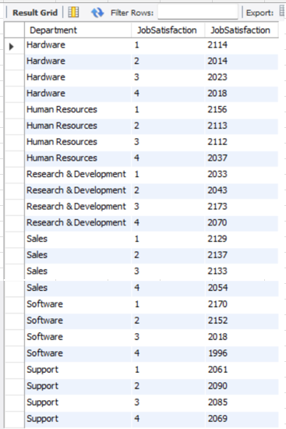
KPI 11(a) – Department wise job satisfaction
Job satisfaction is rated on a scale of 1 to 4. 1 and 4 being lowest and highest respectively.
Research & Development having highest count(2070) of rating 4.
Software having highest count(2170) of rating 1.

Slide 15
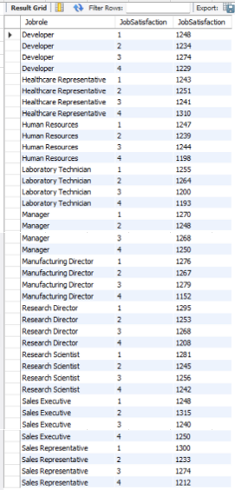
KPI 11(b) – JOB ROLE wise job satisfaction
Job satisfaction is rated on a scale of 1 to 4. 1 and 4 being lowest and highest respectively.
Healthcare representative having highest count(1310) of rating 4.
Sales representative having highest count(1300) of rating 1.

Slide 16
Conclusion
Collect Feedback – Conduct employee engagement surveys to find out the reason for attrition and to take necessary steps to reduce attrition rate.
Work life balance – Improve the work life balance of employees by giving manageable workload.
Pay and Promotion – Ensure that all employees are fairly compensated and those worthy are given promotion.

Slide 17
THANK YOU

